Slide 1
introduction to Kubernetes
dimitris giannopoulos – university of patras – 9/6/2022

Slide 2
Resources
You can find the slides and the necessary resources on GitHub at:
dimitrisgiannopoulos/ADVANCED_PROGRAMMING_TECHNIQUES-Kubernetes

Slide 3
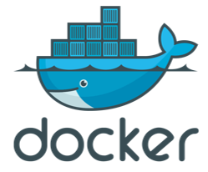
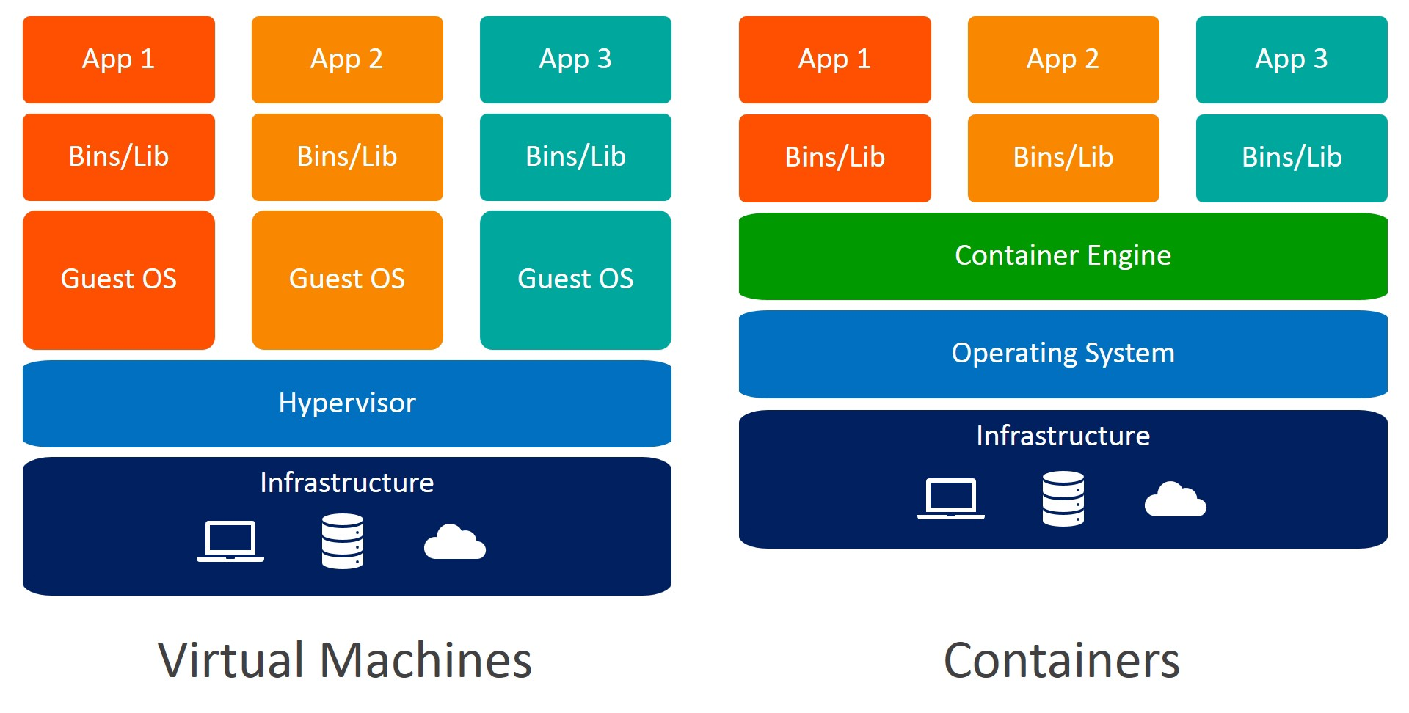
recap: containers with docker
Container Advantages
Small size
Fast deployment
Security
Interoperability
https://www.weave.works/blog/a-practical-guide-to-choosing-between-docker-containers-and-vms
Notes:
interoperability -> multiple OSs, multiple architectures. Security -> isolation, different OSs next door, so one hacked machine doesn’t mean the end. Energy -> smaller resource footprint means less energy.

Slide 4
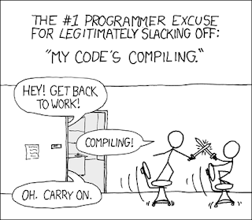
common problems with code
Problem 1: all programmers commit to the same codebase (hard to manage)
Problem 2: one change in the code means repackaging the entire module
Problem 3: difficult to scale, when you have to scale the whole thing
…
Is there a better way?
Notes:
Problem 1: Facebook UI change (one programmer is responsible for changing the UI, but he has to pull all the code to his local machine and change only a small part.

Slide 5
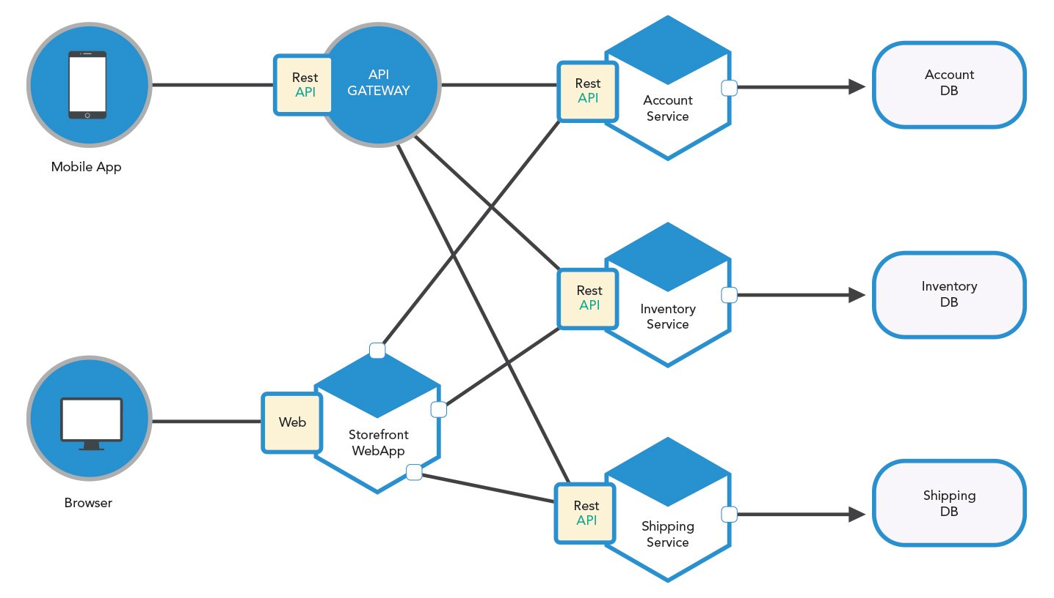
Microservices
e-commerce Application
Multiple independent blocks
Clear block to block communication via API
Isolated codebases
No central DB

Slide 6
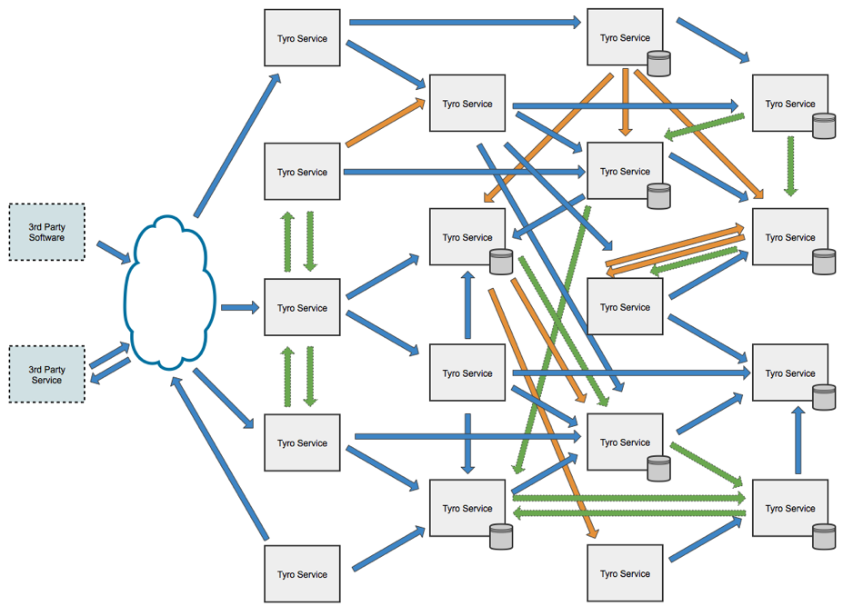
more microservices, higher complexity
After a while things get messy…
What’s the solution?
https://www.grahamlea.com/2015/07/microservices-security-questions/
Notes:
Imagine if a core component suddenly crashes, it could take down the entire service. Not to mention the headache of upgrading a component.

Slide 7
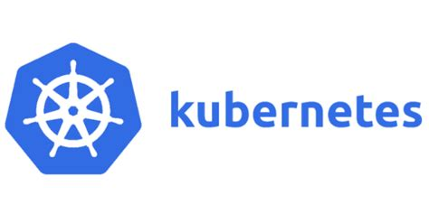
Kubernetes (K8s)
Kubernetes is dominating the major cloud hyper-scalers (AWS, GCP, Microsoft Azure)
Since 2014 it has revolutionized how services are deployed
Most companies use Kubernetes for their services:
Google
Spotify
The New York Times
Pinterest
Adidas
Tinder
Airbnb
…
What is Kubernetes?
Kubernetes is:
open-source
a container orchestrator
originally designed by Google
now maintained by the CNCF
But can it do this?
Kubernetes can handle container:
deployment
scaling
management
https://kubernetes.io/docs/home/
Notes:
Kubernetes (or K8s) is an open-source container-orchestration system for automating computer application deployment, scaling and management.

Slide 8

Kubernetes resources
1) Pod - Pod is a group of one or more containers. The pods are governed by a K8S configuration that guides the behavior of the containers. More about Kubernetes pods here.
2) Service - This is an abstraction that describes the available pods and also defines the ways of accessing them.
3) Volume - Since containers are ephemeral in nature, the volume abstraction in Kubernetes allows data persistency.
Container
Container
Pod
Pod
Container
pod1
pod1
IP
Service
IP
IP’
pod2
pod2

Slide 9
Kubernetes resources
4) Namespace - Namespace allows you to create multiple virtual K8S clusters, each cluster serving a particular purpose or a specific project.
5) ReplicaSet (RS) - A K8S replica set is a service that makes sure necessary pods are running. This service is responsible for recreating new pods in the event of any pod crash.
6) Deployment - Deployments are used to define high availability policies to containers.

Slide 10
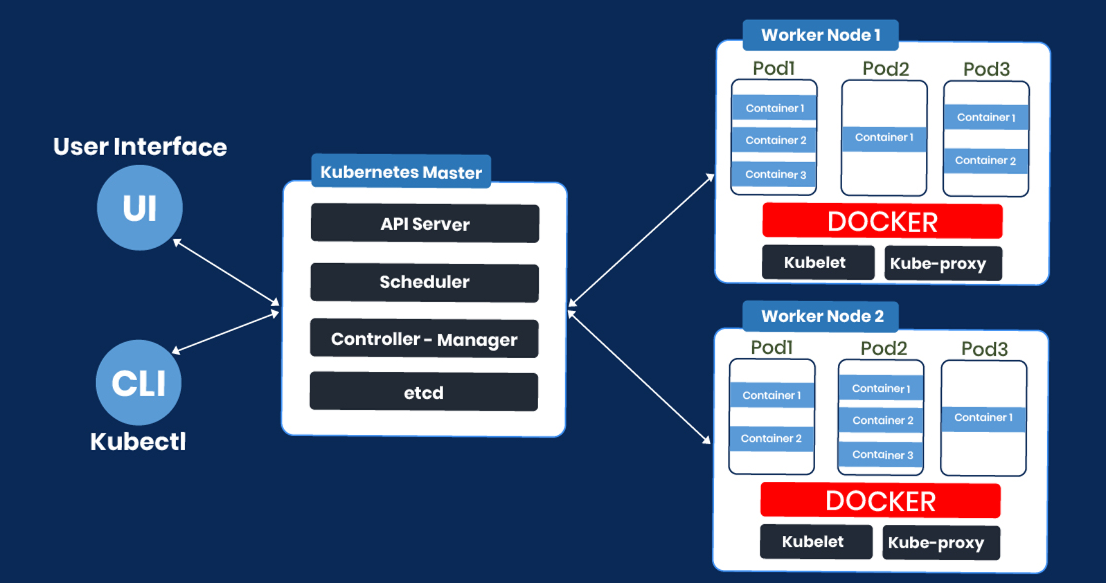
Kubernetes architecture
https://blockchainsimplified.com/blog/kubernetes-the-ultimate-platform-for-containerized-application-management/

Slide 11
Kubernetes Components
Master Components (run on Cluster controller only)
kube-apiserver: exposes the Kubernetes API
etcd: key value store used as Kubernetes' backing store for all cluster data
kube-scheduler: watches for newly created Pods with no assigned node, and selects a node for them to run on
Worker Components (run on every Node in the Cluster)
kubelet: makes sure that containers are running in a Pod
kube-proxy: network proxy, implements part of the Kubernetes Service concept
Container runtime: responsible for running containers (Docker by default)

Slide 12
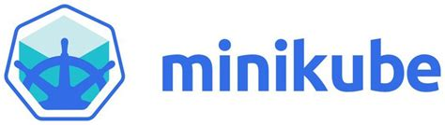
Minikube: A Kubernetes sandbox
Installing Docker (9/2/2022)
sudo apt update
sudo apt upgrade
sudo reboot
sudo apt install docker.io
sudo usermod -a -G docker $USER
sudo groupadd docker && sudo gpasswd -a ${USER} docker && sudo systemctl restart docker
newgrp docker
→ exit and login again
sudo systemctl start docker
sudo systemctl enable docker
https://www.linux.com/topic/desktop/how-install-and-use-docker-linux/

Slide 13
Minikube: A Kubernetes sandbox
Installing Minikube (9/6/2022 on VM)
sudo apt-get update && sudo apt-get install -y apt-transport-https gnupg2
curl -s https://packages.cloud.google.com/apt/doc/apt-key.gpg | sudo apt-key add -
echo "deb https://apt.kubernetes.io/ kubernetes-xenial main" | sudo tee -a /etc/apt/sources.list.d/kubernetes.list
sudo apt-get update
sudo apt-get install -y kubectl
sudo apt-get install conntrack -y
curl -Lo minikube https://storage.googleapis.com/minikube/releases/latest/minikube-linux-amd64
chmod +x minikube
sudo mv minikube /usr/local/bin
sudo -i
minikube start --vm-driver=none
https://developer.ibm.com/tutorials/set-up-minikube-on-ubuntu-server-within-minutes/

Slide 14
Experimentation
let’s build something!

Slide 15
credentials for VMs
Minikube-1: ssh ubuntu@150.140.195.253
Minikube-2: ssh ubuntu@150.140.195.235
Minikube-3: ssh ubuntu@150.140.195.232
Minikube-4: ssh ubuntu@150.140.195.244
password: advancedprog!
sudo -i

Slide 16
experimenting with Kubernetes
kubectl get nodes
kubectl describe nodes
kubectl get pods
kubectl –n kube-system get all

Slide 17
creating a pod
Create your environment
create a directory: mkdir <A.M.>
enter directory: cd <A.M.>
kubectl create ns <A.M.>
Clone GitHub directory
git clone https://github.com/dimitrisgiannopoulos/ADVANCED_PROGRAMMING_TECHNIQUES-Kubernetes.git
cd ADVANCED_PROGRAMMING_TECHNIQUES-Kubernetes/manifests
Create Ubuntu deployment
kubectl apply –f ubuntu-pod.yaml –n <A.M.>
watch kubectl get pods –n <A.M.>
kubectl –n <A.M.> exec -it ubuntu -- /bin/bash

Slide 18
Creating a sample application with deployment
Create deployment
kubectl –n <A.M.> create deployment hello-node --image=k8s.gcr.io/echoserver:1.4
kubectl –n <A.M.> expose deployment hello-node --type=NodePort --port=8080
kubectl –n <A.M.> get services
What is your exposed port number? (Hint: between 30000 and 32767)
in a browser visit: <Virtual Machine IP address>:<hello-node-port-number>
Scale deployment:
kubectl -n <A.M.> scale deployment hello-node --replicas=2

Slide 19
Clean up
kubectl –n <A.M.> delete -f ubuntu-pod.yaml
kubectl –n <A.M.> delete service hello-node
kubectl –n <A.M.> delete deployment hello-node
watch kubectl get all –n <A.M.>

Slide 20
questions?

Slide 21
Thank you!
dimitris giannopoulos

